Slide 1
CAS Presentation – Seniors - 2022

Slide 2
Where Should I be currently with CAS?
-All CAS Experiences loaded into Managebac
-5 Reflections + 5 Pieces of Evidence for each reflection
-1 CAS Project Planning Document + Evidence
-1 CAS Project Execution & Reflection + Evidence

Slide 3
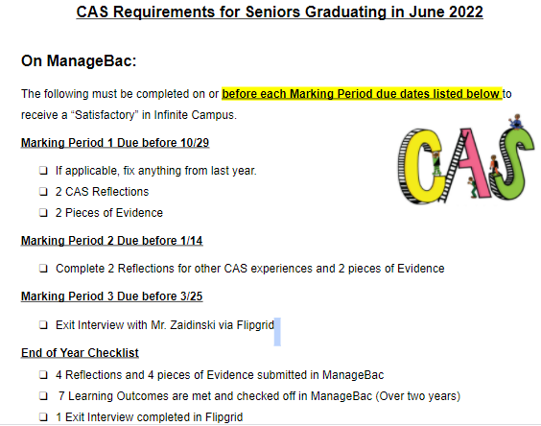
What is Needed for Senior Year?

Slide 4
What else do I need to know about IB CAS?​
Your CAS reflections must: ​
fit within one or more of the CAS strands (C-A-S). ​
be based on a personal interest, skill, talent or opportunity for growth. Examples: Marching Band, Sports Teams, Clubs, Volunteering, etc.​
not involve activities where you preach/teach your faith or speak about your religious beliefs. You may perform service through your religious institution (soup kitchens, carnivals, clothing drives, etc.).​
address each of the 7 CAS Learning Outcomes over two years.​
be uploaded to your ManageBac account.

Slide 5
Seven CAS Learning Outcomes
1: Identify own strengths and develop areas for growth
Students are able to see themselves as individuals with various abilities and skills, of which some are more developed than others.
2: Demonstrate that challenges have been undertaken, developing new skills in the process
A new challenge may be an unfamiliar experience or an extension of an existing one. The newly acquired or developed skills may be shown through experiences that the student has not previously undertaken or through increased expertise in an established area.
3: Demonstrate how to initiate and plan a CAS experience
Students can articulate the stages from conceiving an idea to executing a plan for a CAS experience or series of CAS experiences. This may be accomplished in collaboration with other participants. Students may show their knowledge and awareness by building on a previous experience, or by launching a new idea or process.
4: Show commitment to and perseverance in CAS experiences
Students demonstrate regular involvement and active engagement in CAS.
5: Demonstrate the skills and recognize the benefits of working collaboratively
Students are able to identify, demonstrate and critically discuss the benefits and challenges of collaboration gained through CAS experiences.
6: Demonstrate engagement with issues of global significance
Students are able to identify and demonstrate their understanding of global issues, make responsible decisions, and take appropriate action in response to the issue either locally, nationally or internationally.
7: Recognize and consider the ethics of choices and actions
Students show awareness of the consequences of choices and actions in planning and carrying out CAS experiences.

Slide 6
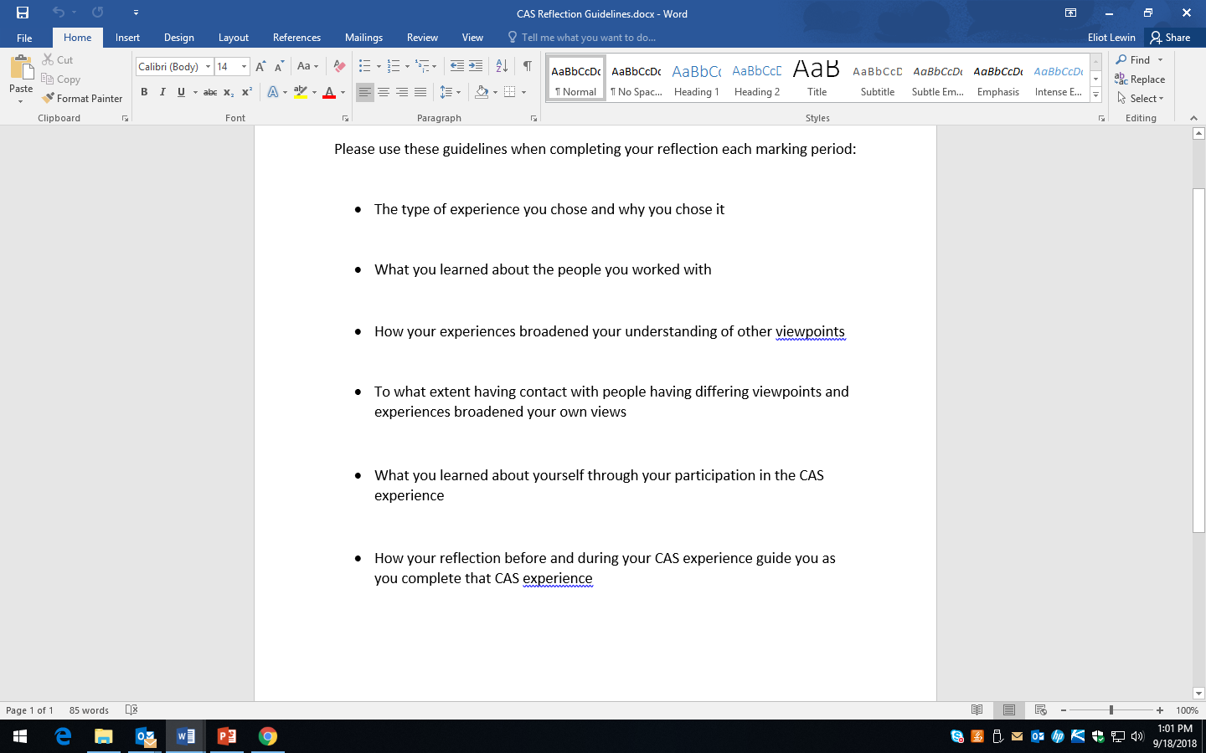
Reflection Guidelines for Each Marking Period

Slide 7
Communication
Please email me at: jzaidinski@commack.k12.ny.us
Please message me through Google Classroom
Please message me through Managebac
Be sure you are subscribed to remind!
I’m here for you!

